Slide 1
Organization and Planning—The Key to Successful Drafts
12th Grade English ESLR

Slide 2
Reflect on your reading & research
You read closely, now step back and look from a wider lens, or scope…
Revisit your subtopics. What have you learned about each?
Now, revisit your overarching research question. What have you learned about the topic in general? Does this statement encompass the subtopics you researched, as well?
Finally, consider the “so what”—Why does this topic matter, or why is it important?

Slide 3
Argument or Informational?
Consider what you have learned and the importance of your topic.
Is your purpose to inform and make recommendations, or is the topic more controversial in nature making your purpose more argumentative?
This doesn’t mean that it’s a “persuasive.” However, if you are making a claim that is debatable, or inherently opinionated, then is an argument paper a more appropriate choice?
If you choose argument, remember that you must include counterclaims—you need to be able to show alternate or different viewpoints and be able to refute or explain why your position or perspective is correct, valid, appropriate, and so forth.
Examine the appropriate CCSS rubric and writing strand to understand the expectations and evaluation criteria for your writing.

Slide 4
Organize…or “outline” the order of ideas in your paper
These “pillars of your paper” will create the foundational structure and be used as subheadings to organize your topic.
Introduction
Subtopic 1
Subtopic 2
Subtopic 3** (Add additional subtopics and Roman numerals as needed.)
Conclusions
Credit: st.pauls.co.uk

Slide 5
These are the pillars of your structure:

Slide 6
Now you have a shell…
But you need to add substance and style to the structure, or else it’s just an empty shell.
Credit: wikimedia.org

Slide 7
Work on introducing your topic in a scholarly manner:
Introduction
Hook/Lead In (You don’t have to make us weep.)
Transition/ Introduce topic**
Brief background, definitions, or other information to orient the reader
Transition to thesis**
Thesis—see next slide.
**as needed
Credit: canterbury-cathedral.org

Slide 8
Draft a thesis statement…
…that reflects the informational or argument-based focus of your paper.
A good thesis will give you room to develop your topic, but it will also give the reader guidance as they read.
A good thesis should reflect your learning from the research.
A good thesis should include MORE than the topic.
A good thesis should include a claim that is then proven through the evidence and discussion.
A good thesis may take time to develop and change throughout the organization and drafting process.
Two sample thesis statements:
A paper addressing the issue of gun control:
While Americans certainly have a legal and historical basis for the right to bear arms, loopholes in gun control laws along with inadequate legal protections and medical treatments for adults with mental illness leave both the patient and the public at great risk.
A paper addressing institutional structures and services for mental health patients:
Though the structure of mental institutions and treatment options have improved significantly over the last century, adults with mental illness still lack adequate services, affordable treatments, and protective orders that are necessary to protect both patients and the public.

Slide 9
Add support and give shape to the essay
This type of formal outline requires COMPLETE SENTENCES. You are FRONTLOADING your work.
Evidence
Direct quotes
Paraphrases
Detailed summaries
AND
Discussion--your annotations could be very helpful with this element of your paper.
Credit: visitlondon.com

Slide 10
Cite ALL sources… even in your outline!
Direct quotes, paraphrases, and summaries…you need to give credit for ANY research you incorporate.
APA style generally requires the following elements for in-text citations:
Author, corporate author, or article title name
Year of publication, if known
Page numbers, if applicable

Slide 11
You can also keep the citations simple during the organizing & drafting phase…
Create a code or system…if you do not want to worry about the parenthetical formatting until later.
Number the articles in the same order as the annotated bibliography. Use these numbers for now as you cite the evidence you include in the outline.
You won’t necessarily copy and paste every parenthetical citation because APA uses a number of ways to cite sources in the paper, but you can methodically work through the citations at a later time and remain consistent throughout the paper.

Slide 12
Number the entries…and then record the source “number” next to each piece of evidence in your outline.
Add pg. #’s for this
one.

Slide 13
The “how” of organizing your information depends upon your topic, research, and thought process.
Credit: canterbury-cathedral.org
Credit: brittanica.com

Slide 14
Simple sample organizational outline for a subtopic: III. Subheading
Topic Sentence Par. 1
Evidence (Source 1)
Discussion
Evidence (Source 3)
Evidence (Source 2, p. 5)
Discussion
Discussion
Evidence (Source 3)
Discussion
Concluding Sentence ** Use if necessary to wrap up the paragraph, don’t just repeat the topic sentence…boring!!
Topic Sentence Par. 2
Discussion
Evidence (Source 1)
Evidence (Source 2, p. 9)
Discussion
Evidence (Source 1- use block quote)
Discussion
Discussion
** Paragraph length is dependent upon the amount of evidence you have from your research and the discussion you can develop relating to that research. Add additional paragraphs as needed. Cite all sources!
***Include complete sentences for evidence and discussion points.

Slide 15
Simple sample organizational outline for a subtopic: IV. Subheading
Topic Sentence Par. 1
Evidence (Source 1)
Discussion
Evidence (Source 3)
Evidence (Source 2, p. 5)
Discussion
Discussion
Evidence (Source 3)
Discussion
Concluding Sentence ** Use if necessary to wrap up the paragraph, don’t just repeat the topic sentence…boring!!
Topic Sentence Par. 2
Discussion
Evidence (Source 1)
Evidence (Source 2, p. 9)
Discussion
Evidence (Source 1- use block quote)
Discussion
Discussion
** Paragraph length is dependent upon the amount of evidence you have from your research and the discussion you can develop relating to that research. Add additional paragraphs as needed. Cite all sources!
***Include complete sentences for evidence and discussion points.

Slide 16
Craft a Conclusion
This may be different from typical essays you have written in the past. It may, in fact, be a couple of paragraphs, depending upon your topic.
Restate the thesis or at least emphasize the overarching idea or claim you make about the topic.
Discuss your conclusions about the topic—Look over each section of your paper. What is important for readers to remember, recognize, or decide? What are the implications of this issue now and in the future? How will this information affect career choices or future studies? Think of this as the “So what?” part of your paper.
Revisit your hook or end with a thought-provoking statement to wrap up your paper.

Slide 17
A very thorough example (A+)

Slide 18
Another excellent outline (A+)

Slide 19
Less developed (B/B-)

Slide 20
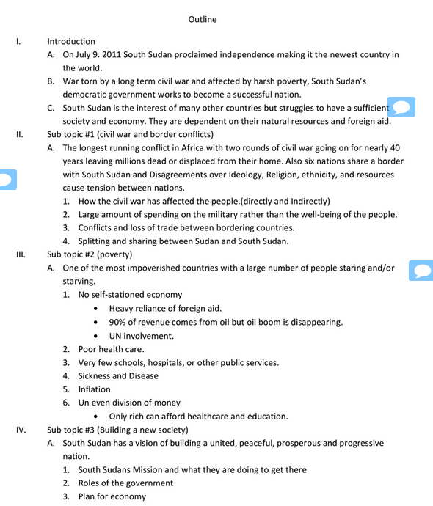
D
The outline
lacks specific evidence
and
complete
points of
discussion.

Slide 21
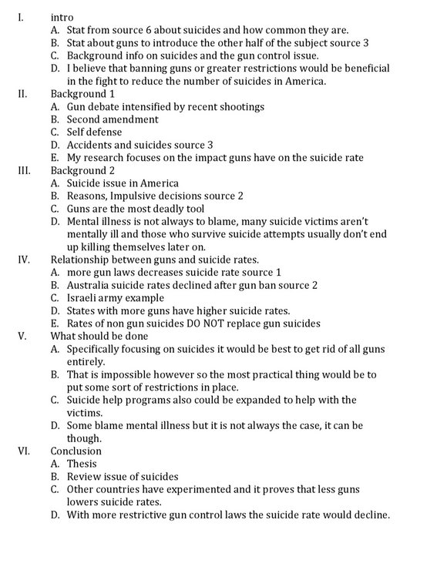
D-
This lacks topic sentences, specific evidence, and complete discussion points.

Slide 22
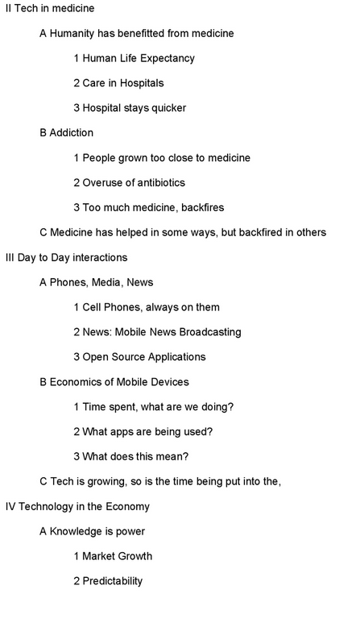
F
This does
not meet expectations of the assignment

Slide 23
Topic sentences—in your own words. Evidence—you must include at least the source number. Discussion—you must include your own thoughts. You can not just list evidence.
Submit the typed outline to Google CLASSROOM by 11:59 pm on Tuesday, May 2nd. You do not need to print a hard copy.

